Slide 1
Large-Scale and Multi-Structured Databases Project Design Manga Universe
Flavio Messina
Feyzan Çolak
Noemi Cherchi

Slide 2

Application Highlights
Application allows user to:
Browse and Search Mangas
Review System
Profile Management
Create and Manage Lists of Manga
Following Customers and See Their Public Information
See Analytics of Mangas and Customers

Slide 3
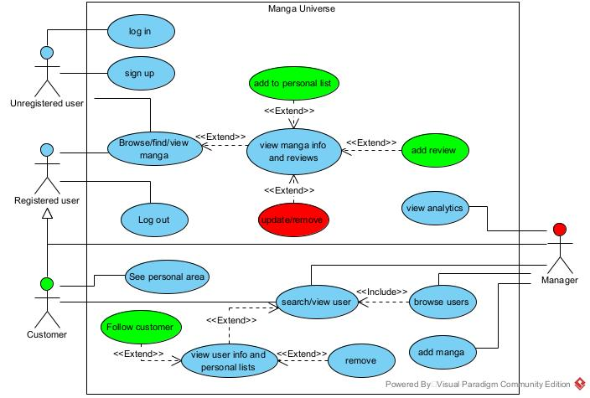
Actors and main supported functionalities

Slide 4
Dataset Description
Source: https://www.kaggle.com/datasets/andreuvallhernndez/myanimelist?select=manga.csv
Description:
Dataset contains 67273 mangas which are last updated on 7th August 2023.
Each data have 30 attributes.
Volume:
67273 mangas
91 MB on json format
Variety:
The dataset is created from one source
Velocity/Variability:
Each day a lot of mangas are updated (chapters, volumes, status). Since the main feature is providing correct information, the database must be updated frequently

Slide 5
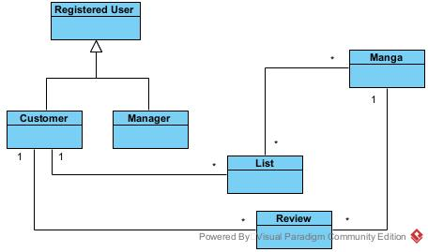
Preliminary UML Class Diagram

Slide 6
Requirements and Entities handled by Document DB
Manga, review and registered user will be stored using a document DB.
The manga dataset was created by an API that collects each manga with different attributes. So using sequal database would have given a lot of null values.
Representing one to many relationships with an array of nested documents in the manga collection. This can be useful to store the reviews inside the manga document.
Using document DB,aggregations can be created that can provide simplified version of complex queries to analyze and retrieve informations quickly.
Creating indexis for fast retrieve of mangas based on their name, publishing date and status.

Slide 7
Requirements and Entities handled by Graph DB
Lists will be stored using graph DB.
Representing the social features of the application, like follower system will be handled with graph DB.
Example of query: Show the list of follower and following of an user.
Show all the users that like manga.
Show all the lists of a user.
Manga
-Author
{like}
{drama,
read again}
User 1
{follow}
User 2

Slide 8
Software Architecture Preliminary Idea
Mongo DB as a document database
Neo4j as a graph database
Java for backend
HTML – CSS – JavaScript for frontend
IntelliJ Idea as IDE to manage project
Tomcat as a web server

